Slide 1
Normality and
Homogeneity tests
16
Probability
and
Statistics
COMS10011
Dr. Anne Roudaut
csxar@bristol.ac.uk
(Thanks S. Massa, Oxford)

Slide 2
continuous independent variable
What type of data?
discrete independent variable
continuous dependent variable
discrete dependent variable
Continuous dependent variable
Discrete/categorical dependent variable
regressions
logistic
regressions
normally distributed
skewed
2 grp
>2 grp
2 grp
>2 grp
2 grp
>2 grp
Non paired
paired
Non paired
paired
Non paired
paired
Non paired
paired
Counts >= 5 in >= 75% cells
Counts >= 5 in < 75% cells
T-test
ANOVA
Mann-Whitney Utest
Wilcoxon signed rank test
Kruskall-Wallis test
Chi-square test
Fisher’s exact test
Chi-square test
Paired-t-test
Friiedman test
McNemar’s test

Slide 3
continuous independent variable
What type of data?
discrete independent variable
continuous dependent variable
discrete dependent variable
Continuous dependent variable
Discrete/categorical dependent variable
regressions
logistic
regressions
normally distributed
skewed
2 grp
>2 grp
2 grp
>2 grp
2 grp
>2 grp
Non paired
paired
Non paired
paired
Non paired
paired
Non paired
paired
Counts >= 5 in >= 75% cells
Counts >= 5 in < 75% cells
T-test
ANOVA
Mann-Whitney Utest
Wilcoxon signed rank test
Kruskall-Wallis test
Chi-square test
Fisher’s exact test
Chi-square test
Paired-t-test
Friiedman test
McNemar’s test

Slide 4
today::
look into assumption of normality and of homogeneity
see what to do otherwise

Slide 5
tests we have seen so far (t-test, anova) assume that data follow curve of normal distribution and have homogenous variance

Slide 6
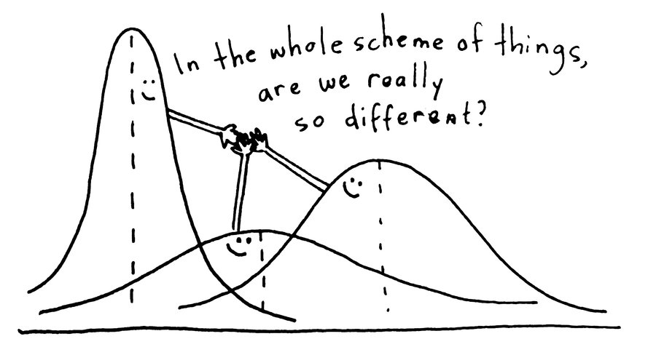
but if we have
distributions like this …
… or that

Slide 7

we cannot use Ttest and Anova

Slide 8
use parametric tests (ttest, anova)
if data follow curve of normal distribution with homogeneous variance
otherwise …
use non-parametric tests

Slide 9
assumption of normality

Slide 10
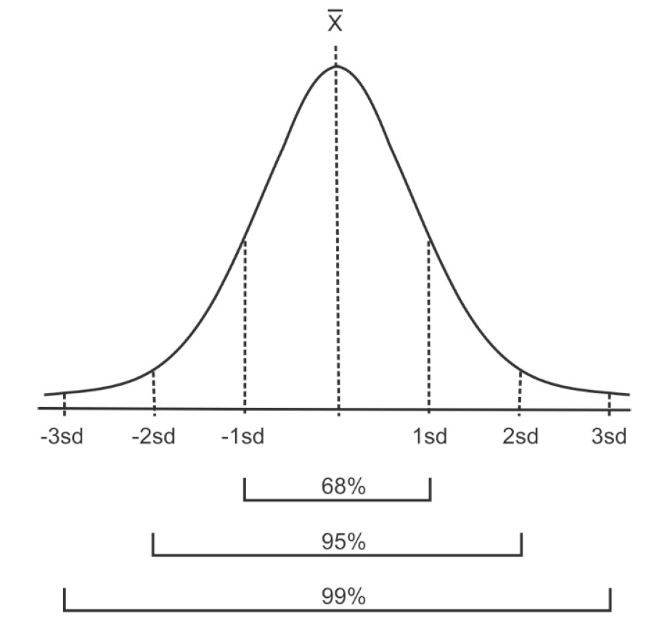
given the mean and standard deviation of a dataset = a theoretical normal distribution has those proportions (Z-score)

Slide 11
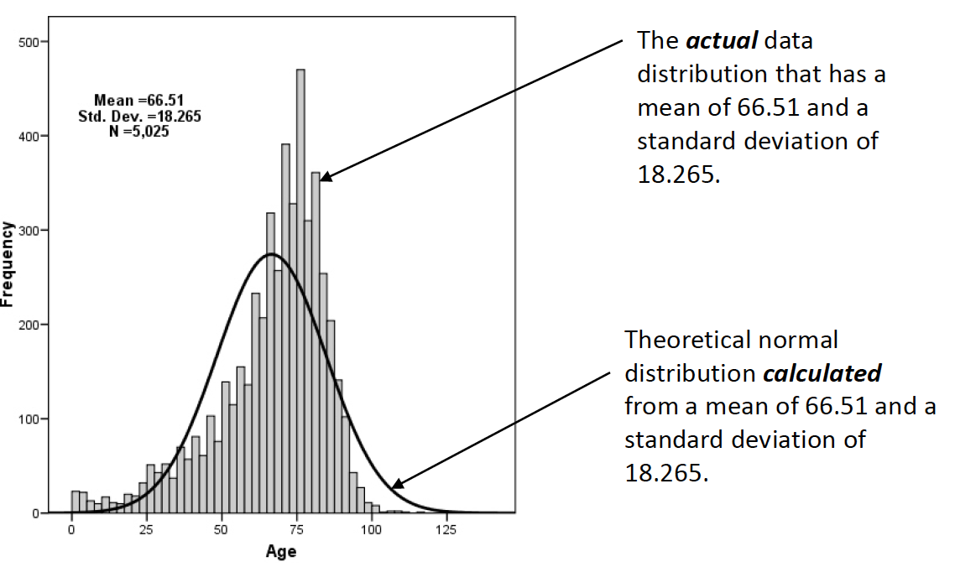
this theoretical normal distribution can then be compared to the actual distribution of the data.
<are the actual data statistically different than the computed normal curve? >

Slide 12
several methods to check that, we are only going to look at two: Kolmogorov-Smirnov test and Shapiro-Wilks test

Slide 13
Kolmogorov-Smirnov
works best for data sets with n > 50
not sensitive to problems in the tails
Shapiro-Wilks
works best for data sets with n < 50
doesn't work well if several values are same

Slide 14
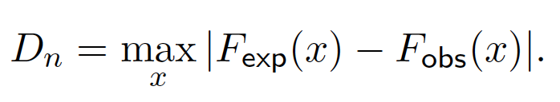
1
Kolmogorov-Smirnov test
cumulative distribution function observed
cumulative distribution function expected
can generate a p-value

Slide 15
0.16 -0.68 -0.32 -0.85 0.89 -2.28 0.63 0.41 0.15 0.74
1.30 -0.13 0.80 -0.75 0.28 -1.00 0.14 -1.38 -0.04 -0.25
-0.17 1.29 0.47 -1.23 0.21 -0.04 0.07 -0.08 0.32 -0.17
0.13 -1.94 0.78 0.19 -0.12 -0.19 0.76 -1.48 -0.01 0.20
-1.97 -0.37 3.08 -0.40 0.80 0.01 1.32 -0.47 2.29 -0.26
-1.52 -0.06 -1.02 1.06 0.60 1.15 1.92 -0.06 -0.19 0.67
0.29 0.58 0.02 2.18 -0.04 -0.13 -0.79 -1.28 -1.41 -0.23
0.65 -0.26 -0.17 -1.53 -1.69 -1.60 0.09 -1.11 0.30 0.71
-0.88 -0.03 0.56 -3.68 2.40 0.62 0.52 -1.25 0.85 -0.09
-0.23 -1.16 0.22 -1.68 0.50 -0.35 -0.35 -0.33 -0.24 0.25
does the following sample of n=100 comes from a normality distributed population?

Slide 16
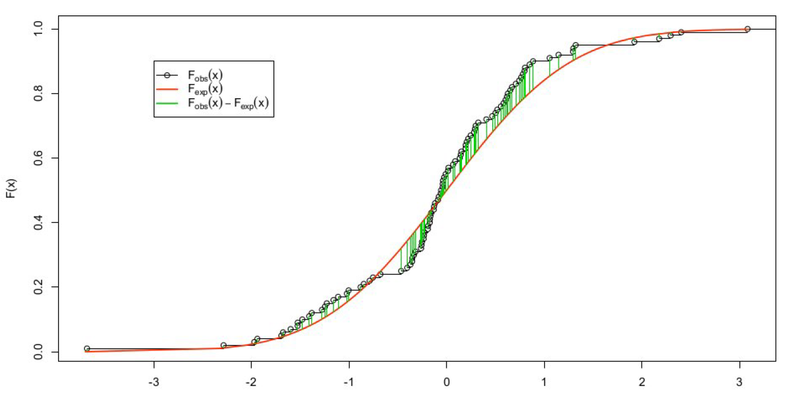
intuitively, we search for the maximum absolute distance between our data cumulative distribution function and the normal cumulative distribution function

Slide 17
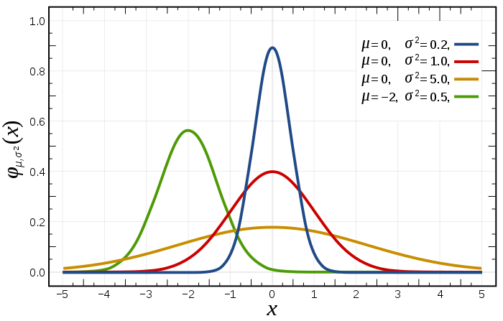
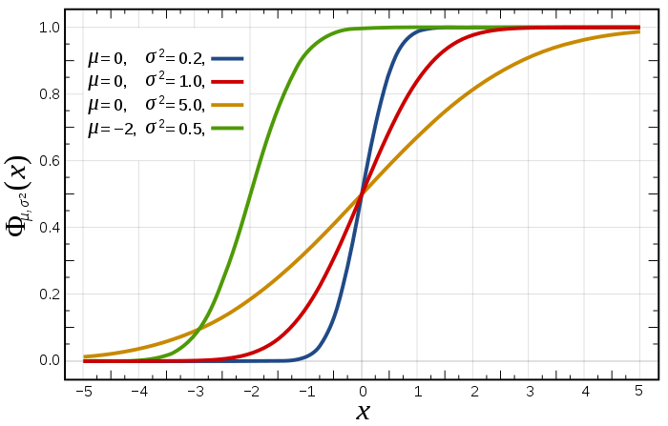
another way to represent probability density function = cumulative distribution function, represents probability that the variable takes a value less than or equal to x

Slide 18
0.16 -0.68 -0.32 -0.85 0.89 -2.28 0.63 0.41 0.15 0.74
1.30 -0.13 0.80 -0.75 0.28 -1.00 0.14 -1.38 -0.04 -0.25
-0.17 1.29 0.47 -1.23 0.21 -0.04 0.07 -0.08 0.32 -0.17
0.13 -1.94 0.78 0.19 -0.12 -0.19 0.76 -1.48 -0.01 0.20
-1.97 -0.37 3.08 -0.40 0.80 0.01 1.32 -0.47 2.29 -0.26
-1.52 -0.06 -1.02 1.06 0.60 1.15 1.92 -0.06 -0.19 0.67
0.29 0.58 0.02 2.18 -0.04 -0.13 -0.79 -1.28 -1.41 -0.23
0.65 -0.26 -0.17 -1.53 -1.69 -1.60 0.09 -1.11 0.30 0.71
-0.88 -0.03 0.56 -3.68 2.40 0.62 0.52 -1.25 0.85 -0.09
-0.23 -1.16 0.22 -1.68 0.50 -0.35 -0.35 -0.33 -0.24 0.25
does the following sample of n=100 comes from a normality distributed population?

Slide 19
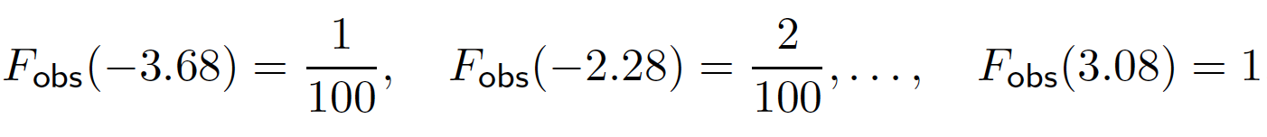
1. order the data:
-3.68 -2.28 -1.97 -1.94 -1.69 -1.68 -1.60 -1.53 -1.52 -1.48
-1.41 -1.38 -1.28 -1.25 -1.23 -1.16 -1.11 -1.02 -1.00 -0.88
-0.85 -0.79 -0.75 -0.68 -0.47 -0.40 -0.37 -0.35 -0.35 -0.33
-0.32 -0.26 -0.26 -0.25 -0.24 -0.23 -0.23 -0.19 -0.19 -0.17
-0.17 -0.17 -0.13 -0.13 -0.12 -0.09 -0.08 -0.06 -0.06 -0.04
-0.04 -0.04 -0.03 -0.01 0.01 0.02 0.07 0.09 0.13 0.14
0.15 0.16 0.19 0.20 0.21 0.22 0.25 0.28 0.29 0.30
0.32 0.41 0.47 0.50 0.52 0.56 0.58 0.60 0.62 0.63
0.65 0.67 0.71 0.74 0.76 0.78 0.80 0.80 0.85 0.89
1.06 1.15 1.29 1.30 1.32 1.92 2.18 2.29 2.40 3.08
2. compute the empirical distribution function
0.01 0.02 0.03 0.04 0.05 0.06 0.07 0.08 0.09 0.10 0.11 0.12 0.13 0.14 0.15 0.16 0.17 0.18 0.19 0.20 0.21 0.22 0.23 0.24 0.25 0.26 0.27 0.28 0.29 0.30 0.31 0.32 0.33 0.34 0.35 0.36 0.37 0.38 0.39 0.40 0.41 0.42 0.43 0.44 0.45 0.46 0.47 0.48 0.49 0.50 0.51 0.52 0.53 0.54 0.55 0.56 0.57 0.58 0.59 0.60 0.61 0.62 0.63 0.64 0.65 0.66 0.67 0.68 0.69 0.70 0.71 0.72 0.73 0.74 0.75 0.76 0.77 0.78 0.79 0.80 0.81 0.82 0.83 0.84 0.85 0.86 0.87 0.88 0.89 0.90 0.91 0.92 0.93 0.94 0.95 0.96 0.97 0.98 0.99 1.00
Notes:
y<-c(0.16,-0.68,-0.32,-0.85,0.89,-2.28,0.63,0.41,0.15,0.74,1.30,-0.13,0.80,-0.75,0.28,-1.00,0.14,-1.38,-0.04,-0.25,-0.17,1.29,0.47,-1.23,0.21,-0.04,0.07,-0.08,0.32,-0.17,0.13,-1.94,0.78,0.19,-0.12,-0.19,0.76,-1.48,-0.01,0.20,-1.97,-0.37,3.08,-0.40,0.80,0.01,1.32,-0.47,2.29,-0.26,-1.52,-0.06,-1.02,1.06,0.60,1.15,1.92,-0.06,-0.19,0.67,0.29,0.58,0.02,2.18,-0.04,-0.13,-0.79,-1.28,-1.41,-0.23,0.65,-0.26,-0.17,-1.53,-1.69,-1.60,0.09,-1.11,0.30,0.71,-0.88,-0.03,0.56,-3.68,2.40,0.62,0.52,-1.25,0.85,-0.09,-0.23,-1.16,0.22,-1.68,0.50,-0.35,-0.35,-0.33,-0.24,0.25)
ysorted <- sort(y)

Slide 20

3. for each observation xi from the data, compute:
(in this case, the expected distribution function is standard normal so use the normal table)
0.01 0.02 0.03 0.04 0.05 0.06 0.07 0.08 0.09 0.10 0.11 0.12 0.13 0.14 0.15 0.16 0.17 0.18 0.19 0.20 0.21 0.22 0.23 0.24 0.25 0.26 0.27 0.28 0.29 0.30
0.31 0.32 0.33 0.34 0.35 0.36 0.37 0.38 0.39 0.40 0.41 0.42 0.43 0.44 0.45 0.46 0.47 0.48 0.49 0.50 0.51 0.52 0.53 0.54 0.55 0.56 0.57 0.58 0.59 0.60
0.61 0.62 0.63 0.64 0.65 0.66 0.67 0.68 0.69 0.70 0.71 0.72 0.73 0.74 0.75 0.76 0.77 0.78 0.79 0.80 0.81 0.82 0.83 0.84 0.85 0.86 0.87 0.88 0.89 0.90
0.91 0.92 0.93 0.94 0.95 0.96 0.97 0.98 0.99 1.00

Slide 21

now we have two tables Fobs and Fexp …
4. lets compute the absolute difference between the two and find the highest value
0.01 0.02 0.01 0.01 0.02 0.02 0.02 0.03 0.04 0.04
0.04 0.05 0.04 0.04 0.05 0.06 0.07 0.07 0.08 0.08
0.09 0.09 0.09 0.06 -0.04 -0.05 -0.05 -0.04 -0.03 -0.04
-0.03 -0.04 -0.03 -0.02 -0.01 0.00 0.01 0.01 0.02 0.03
0.04 0.05 0.03 0.04 0.05 0.06 0.06 0.06 0.07 0.08
0.09 0.10 0.11 0.12 0.11 0.12 0.12 0.13 0.13 0.11
0.12 0.12 0.13 0.14 0.15 0.16 0.17 0.18 0.19 0.19
0.18 0.12 0.11 0.10 0.11 0.10 0.08 0.09 0.08 0.09
0.09 0.09 0.10 0.10 0.10 0.11 0.11 0.12 0.13 0.11
0.06 0.06 0.04 0.05 0.06 -0.02 -0.03 -0.02 -0.01 0.00
this is the D searched

Slide 22
we have calculated the maximum absolute distance between expected and observed distribution functions

Slide 23
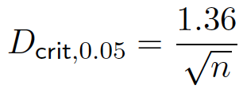
5. at 95% level the critical value is approximately given by
we have a sample size of n = 100 so Dcrit = 0.136
and 0.19 > 0.136

Slide 24
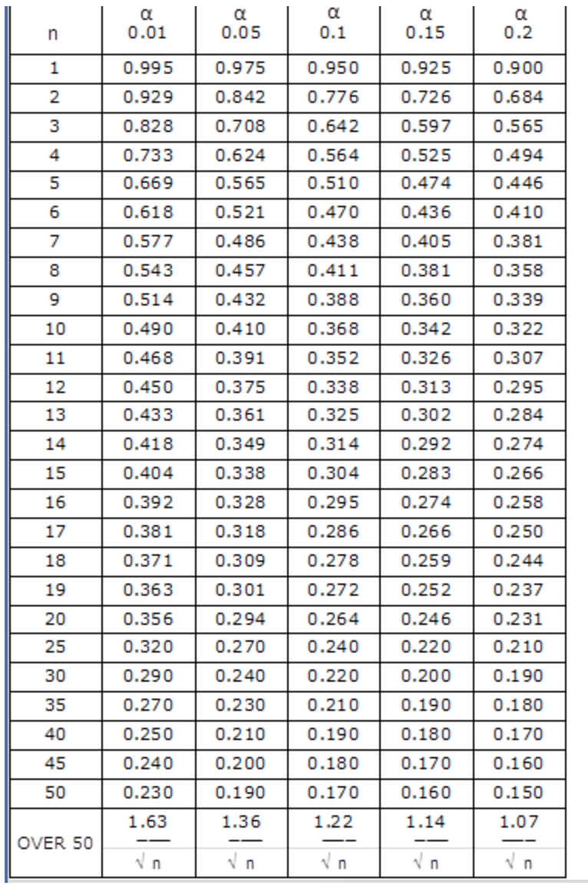
there is a plethora of tables / sampling distributions that are established and are the basis of all statistic tests

Slide 25
so 0.19 > 0.136 so null hypothesis rejected
H0: the samples come from a normal distribution
conclusion: data not following a normal distribution

Slide 26
what if Dn < Dcrit?
here is a tricky bit … remember lecture on hypothesis testing, we cannot prove that two things are equal so we are going to assume that the normality is met
which is why we call this assumption of normality
more example on GitHub repository or at
http://www.real-statistics.com/tests-normality-and-symmetry/statistical-tests-normality-symmetry/kolmogorov-smirnov-test/

Slide 27
R
y <-c(0.16,-0.68,-0.32,-0.85,0.89,-2.28,0.63,0.41,0.15,0.74,1.30,-0.13,0.80,-0.75,0.28,-1.00,0.14,-1.38,-0.04,-0.25,-0.17,1.29,0.47,-1.23,0.21,-0.04,0.07,-0.08,0.32,-0.17,0.13,-1.94,0.78,0.19,-0.12,-0.19,0.76,-1.48,-0.01,0.20,-1.97,-0.37,3.08,-0.40,0.80,0.01,1.32,-0.47,2.29,-0.26,-1.52,-0.06,-1.02,1.06,0.60,1.15,1.92,-0.06,-0.19,0.67,0.29,0.58,0.02,2.18,-0.04,-0.13,-0.79,-1.28,-1.41,-0.23,0.65,-0.26,-0.17,-1.53,-1.69,-1.60,0.09,-1.11,0.30,0.71,-0.88,-0.03,0.56,-3.68,2.40,0.62,0.52,-1.25,0.85,-0.09,-0.23,-1.16,0.22,-1.68,0.50,-0.35,-0.35,-0.33,-0.24,0.25)
X <- rnorm(100)
ks.test(X,y)
Two-sample Kolmogorov-Smirnov test
data: X and y
D = 0.19, p-value = 0.05410262
alternative hypothesis: two-sided
#note that if you run the code you will have different D (because of the random rnorm generation) but likely that your pvalue will always be above 0.05
Notes:
X <- rnorm(100)
p = ecdf(X)
X = sort(X)
fexp <- p(X)
fobs <- p(ysorted)
KS = max(abs(fexp-fobs))
KS
ks.test(X,y)

Slide 28
Kolmogorov-Smirnov works well with sample size > 50 but when the sample is smaller Shapiro-Wilks works best

Slide 29
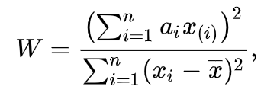
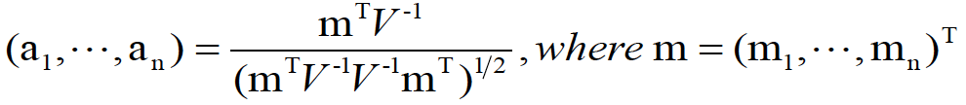
2
Shapiro-Wilks test
x(i) is the ith order statistic
SS (sum of squared difference)
m1, ..., mn are the expected values of the order
statistics of independent and identically
distributed random variables sampled from the
standard normal distribution, and V is the
covariance matrix of those order statistics.
can generate a p-value

Slide 30
more beefy but let’s go steps by steps …

Slide 31
3.83 3.16 4.70 3.97 2.03 2.87 3.65 5.09
does the following sample comes from a normality distributed population?
1. order the data:
2.03 2.87 3.16 3.65 3.83 3.97 4.70 5.09
2. divide them in two
2.03 2.87 3.16 3.65 3.83 3.97 4.70 5.09

Slide 32
2.03 2.87 3.16 3.65 3.83 3.97 4.70 5.09
3. compute di the differences between both
3.06
1.83
0.81
0.18
4. multiply each of these by ai

Slide 33
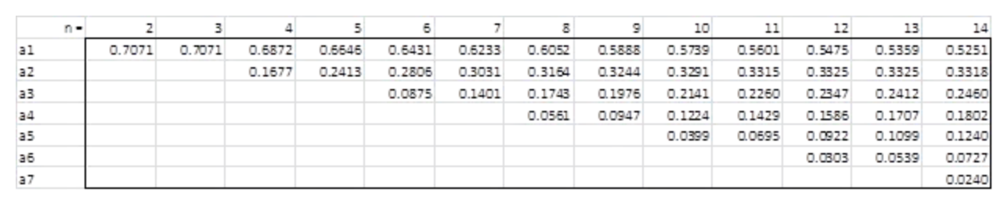
good new we have shapiro-wilk table
…
di
ai
=
=
=
=
3.06
1.83
0.81
0.18
0.6052
0.3164
0.1743
0.0561
1.851912
0.579012
0.141183
0.010098
*
*
*
*
total: 2.582205

Slide 34
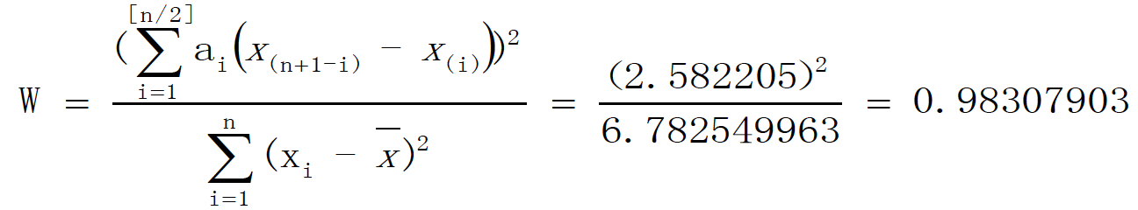
5. Divide it
6. from the reference table of W (another table yeah!),
Wcrit(n=8 at 0.05)=0.818
and 0.983>Wcrit

Slide 35
0.983>Wcrit, so we cannot reject null hypothesis, so we assume the data follows a normal distribution
otherwise (if <) we could reject the null hypothesis and conclude with 95% confidence that that the data are not normally distributed
note we search for value below a critical level to reject the null, this is quite different from the results using the Kolmogorov-Smirnov test where this is the opposite
more example on GitHub repository or at
http://www.real-statistics.com/tests-normality-and-symmetry/statistical-tests-normality-symmetry/shapiro-wilk-test/

Slide 36
R
y <-c(3.83, 3.16, 4.70, 3.97, 2.03, 2.87, 3.65, 5.09)
shapiro.test(y)
Shapiro-Wilk normality test
data: y
W = 0.98317, p-value = 0.9769
= we cannot reject the null hypothesis and we assume the data is normally distributed

Slide 37
assumption of homogeneity

Slide 38
ANOVA we did when we tried to check if chocolate improves memorization

Slide 39
R
# we ran the one-way anova
dat = read.csv("HCIXP-anova.csv", header = TRUE)
library(ez)
ezANOVA(dat,id,between=group,dv=score)
Effect DFn DFd F p p<.05 ges
1 group 2 57 154.8886 9.056612e-24 * 0.8445923
$`Levene's Test for Homogeneity of Variance`
DFn DFd SSn SSd F p p<.05
1 2 57 1.433333 29.3 1.394198 0.2563608

Slide 40
the levene’s test checks for homogeneity of variances (null hypothesis is that all variances are equal)
we won’t go in detail with this test but the most important is this:
if p-value < 0.05 means variances not equal and parametric tests such as ANOVA are not suited (need non-parametric tests)

Slide 41
we know how to check our data … now what?

Slide 42
use parametric tests (ttest, anova)
if data follow curve of normal distribution with homogeneous variance
otherwise …
use non-parametric tests

Slide 43
but if your data is not normally distributed you could also try to make it normal using transformations
… more generally because parametric tests are more robust than non-parametric ones

Slide 44
transformations

Slide 45
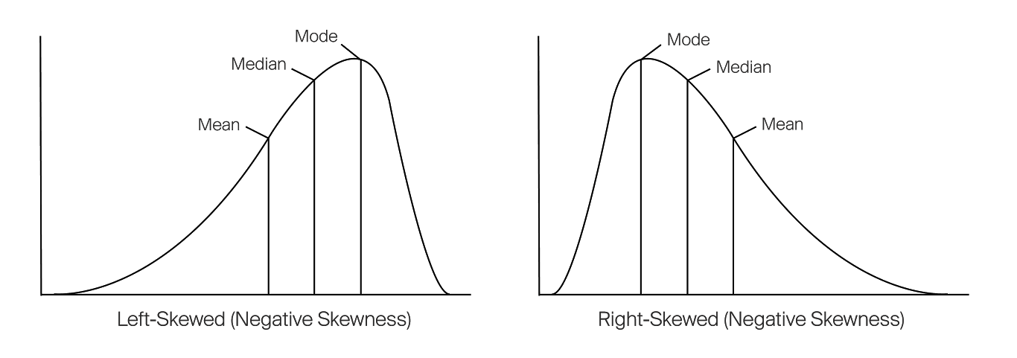

Slide 46
common transformations for left skewed::
square root, cube root, log

Slide 48
common transformations for right skewed::
square, cube root and logarithmic

Slide 50
sometimes skewed distributions could come from outliers so make sure to get rid of them!
sometimes it does not work …

Slide 51
example

Slide 52
R
y <-c(1.0, 1.2, 1.1, 1.1, 2.4, 2.2, 2.6, 4.1, 5.0, 10.0, 4.0, 4.1, 4.2, 4.1, 5.1, 4.5, 5.0, 15.2, 10.0, 20.0, 1.1, 1.1, 1.2, 1.6, 2.2, 3.0, 4.0, 10.5)
hist(y)
qqnorm(y)
qqline(y)
y_sqrt = sqrt(y) #cube root
y_cub = sign(y) * abs(y)^(1/3) #square root
y_log = log(y) #logarithm
# you can now try
qqnorm(y_log)
qqline(y_log)

Slide 53
you have tried everything and still not good?

Slide 54
continuous independent variable
What type of data?
discrete independent variable
we can choose between parametric (normal) or non-parametric (skewed) test
continuous dependent variable
discrete dependent variable
Continuous dependent variable
Discrete/categorical dependent variable
regressions
logistic
regressions
normally distributed
skewed
2 grp
>2 grp
2 grp
>2 grp
2 grp
>2 grp
Non paired
paired
Non paired
paired
Non paired
paired
Non paired
paired
Counts >= 5 in >= 75% cells
Counts >= 5 in < 75% cells
T-test
ANOVA
Mann-Whitney Utest
Wilcoxon signed rank test
Kruskall-Wallis test
Chi-square test
Fisher’s exact test
Chi-square test
Paired-t-test
Friiedman test
McNemar’s test

Slide 55
summary

Slide 56
take away
Give the names of tests we can use to check normality and explain their differences and when to use them
Explain what is the goal of a test of homogeneity of variance and what to do if the variances are not equal
I will not ask you to them by hand in the exam
Explain what to do if the data are not normal (either transforming the data or using non-parametric tests)

Slide 57
end

